Slide 1


Sentiment Classification with Bidirectional LSTM and Attention
This presentation will cover the development of a robust IMDB sentiment classifier. We address the limitations of basic LSTM models by leveraging PyTorch for advanced sequence modeling. This approach aims to classify movie reviews with improved accuracy and handle nuanced language effectively.
by Aryan

Slide 2
Project Objective: Robust Sentiment Analysis
Accurate Classification
Nuanced Language
State-of-the-Art
Classify movie reviews as positive or negative with high accuracy.
Improve performance on complex language, including negations.
Achieve superior results on the IMDB dataset.
Our benchmark is to exceed the prior state-of-the-art accuracy of 89.2%, targeting 92% or higher. This will demonstrate the effectiveness of our approach.

Slide 3
The Problem: Limitations of Basic LSTM
Long-Range Dependencies
Negation Handling
Standard LSTMs struggle with capturing relationships between distant words.
Basic LSTMs often misclassify sentences with negations, like "I don't like this movie."
Our base LSTM achieved only 84.5% accuracy on the IMDB dataset. This highlights the need for a more sophisticated approach to capture contextual information effectively.

Slide 4



Solution: Bidirectional LSTM with Attention
Bidirectional LSTM
Processes sequences in both forward and backward directions.
Attention Mechanism
Weights different parts of the input sequence based on relevance.
Focus on Relevant Words
Captures negations and complex structures.
This architecture allows the model to focus on the most salient words for sentiment prediction, improving overall accuracy.

Slide 5
Methodology: Embedding Layer
Word Embeddings
Pre-trained GloVe
Fine-tuning
Map words to a high-dimensional vector space (e.g., 300 dimensions).
Initialized with pre-trained GloVe embeddings (840B tokens) for better starting point.
Embeddings are fine-tuned during training to adapt to the specific task.
Vocabulary size is reduced to the 20,000 most frequent words to manage complexity and improve training efficiency.

Slide 6



Methodology: Bidirectional LSTM
2
Backward Pass
Processes the sequence from end to beginning.
Two LSTMs
Forward pass processes the sequence from beginning to end.
1
Hidden State Size
256 units per LSTM to capture sufficient contextual information.
3
The concatenated hidden states serve as input to the attention layer, combining information from both directions.

Slide 7



Methodology: Attention Mechanism
Attention Weights
Calculated based on LSTM outputs to determine word importance.
Dot-Product Attention
Used for simplicity and computational efficiency.
Weighted Sum
Used for classification to focus on important words.
This mechanism allows the model to focus on salient words such as adjectives and adverbs, which are crucial for sentiment analysis.

Slide 8
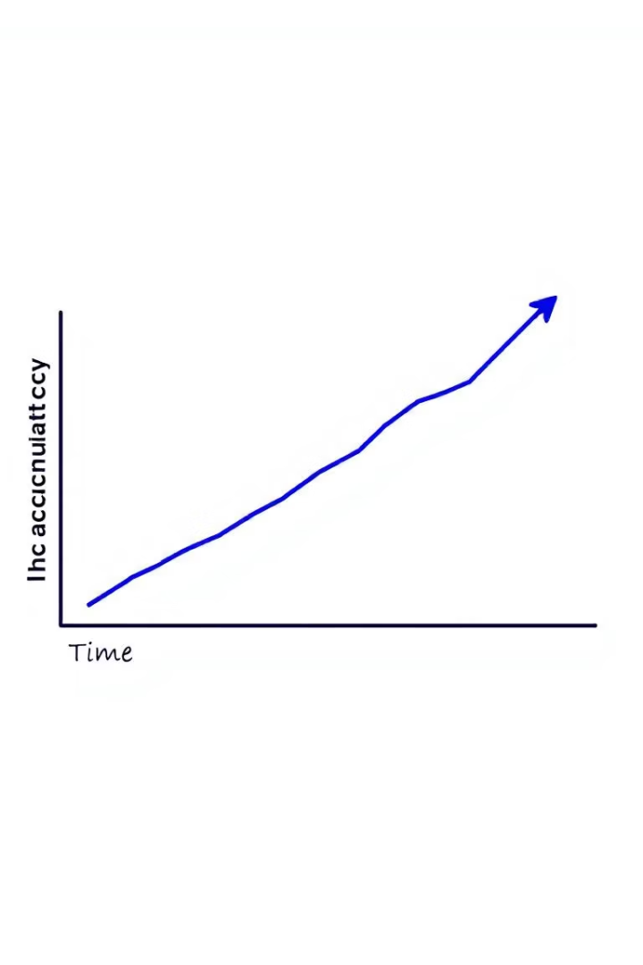
Results and Evaluation
93.5%
Accuracy on IMDB test set. Significant improvement.
84.5%
Base LSTM accuracy. The BiLSTM+Attention is a huge leap.
Ablation studies showed that attention contributes 3% and the BiLSTM contributes 5% to the overall improvement in accuracy. This highlights the importance of each component.

Slide 9
Conclusion
1
Performance gains
Bidirectional LSTM with attention provides optimised performance.
2
Effective Handling
Handles complex language and negations effectively.
3
Flexible Framework
PyTorch provides a flexible framework for implementation.
Future work includes exploring transformers and other advanced attention mechanisms to further improve sentiment classification accuracy.

